Slide 1
Convolutional Neural Networks (CNN)
Dr.Varodom Toochinda
Dept. of Mechanical Engineering
Kasetsart University

Slide 2
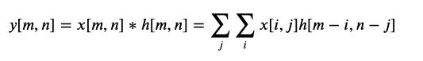
Convolution in image processing

Slide 3
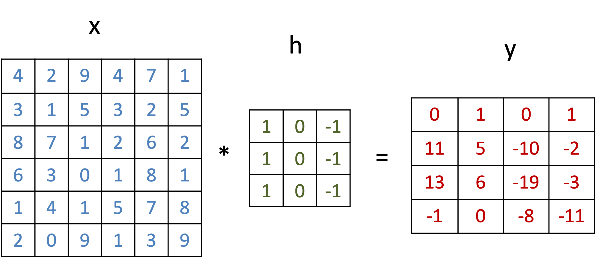
2D convolution example

Slide 4
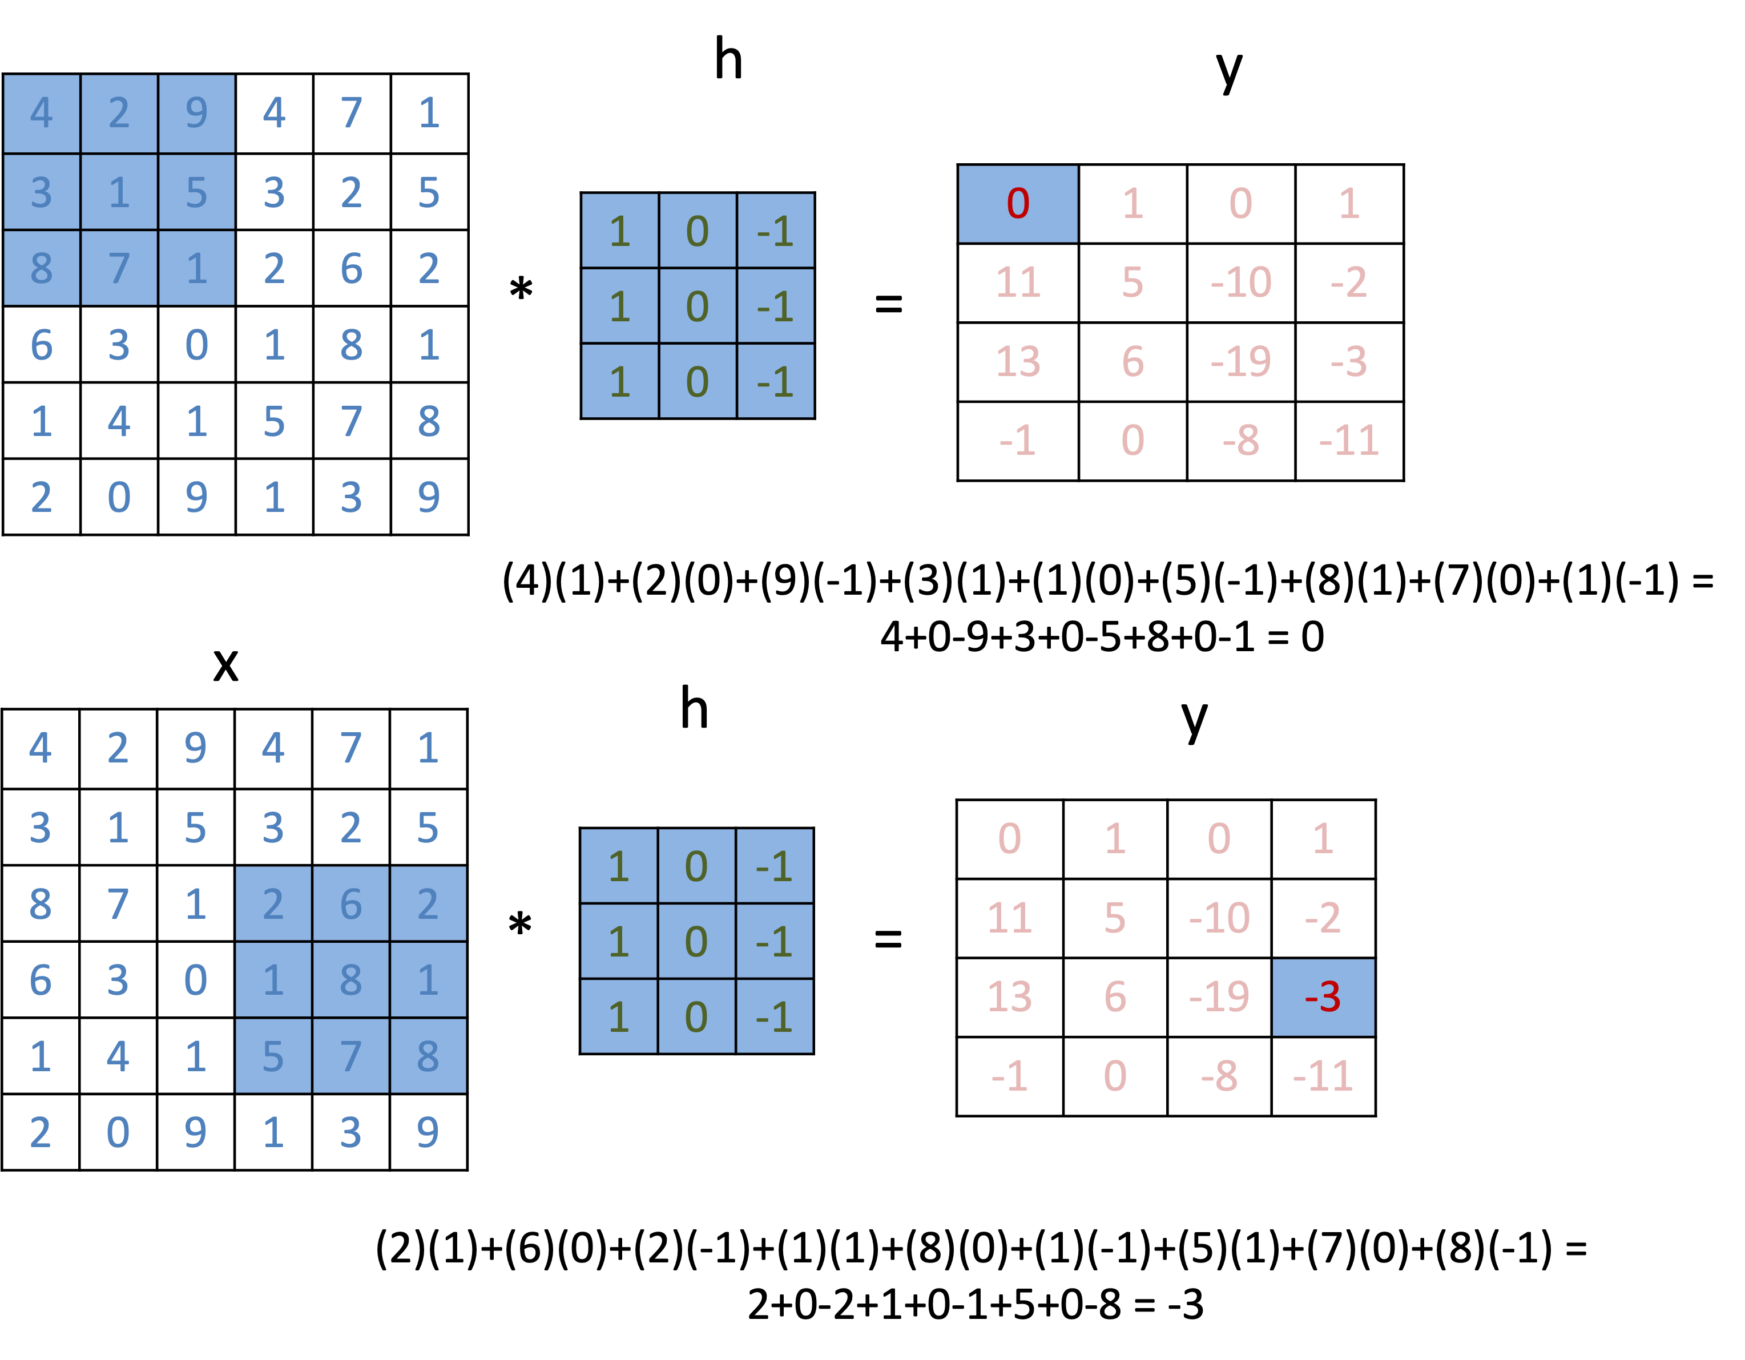
2D convolution example

Slide 5
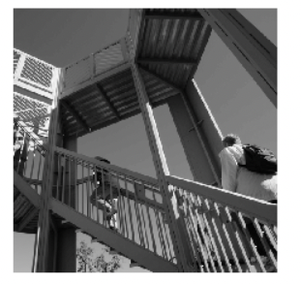
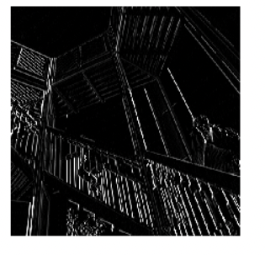
edge detection with convolution
see convolution.ipynb

Slide 6
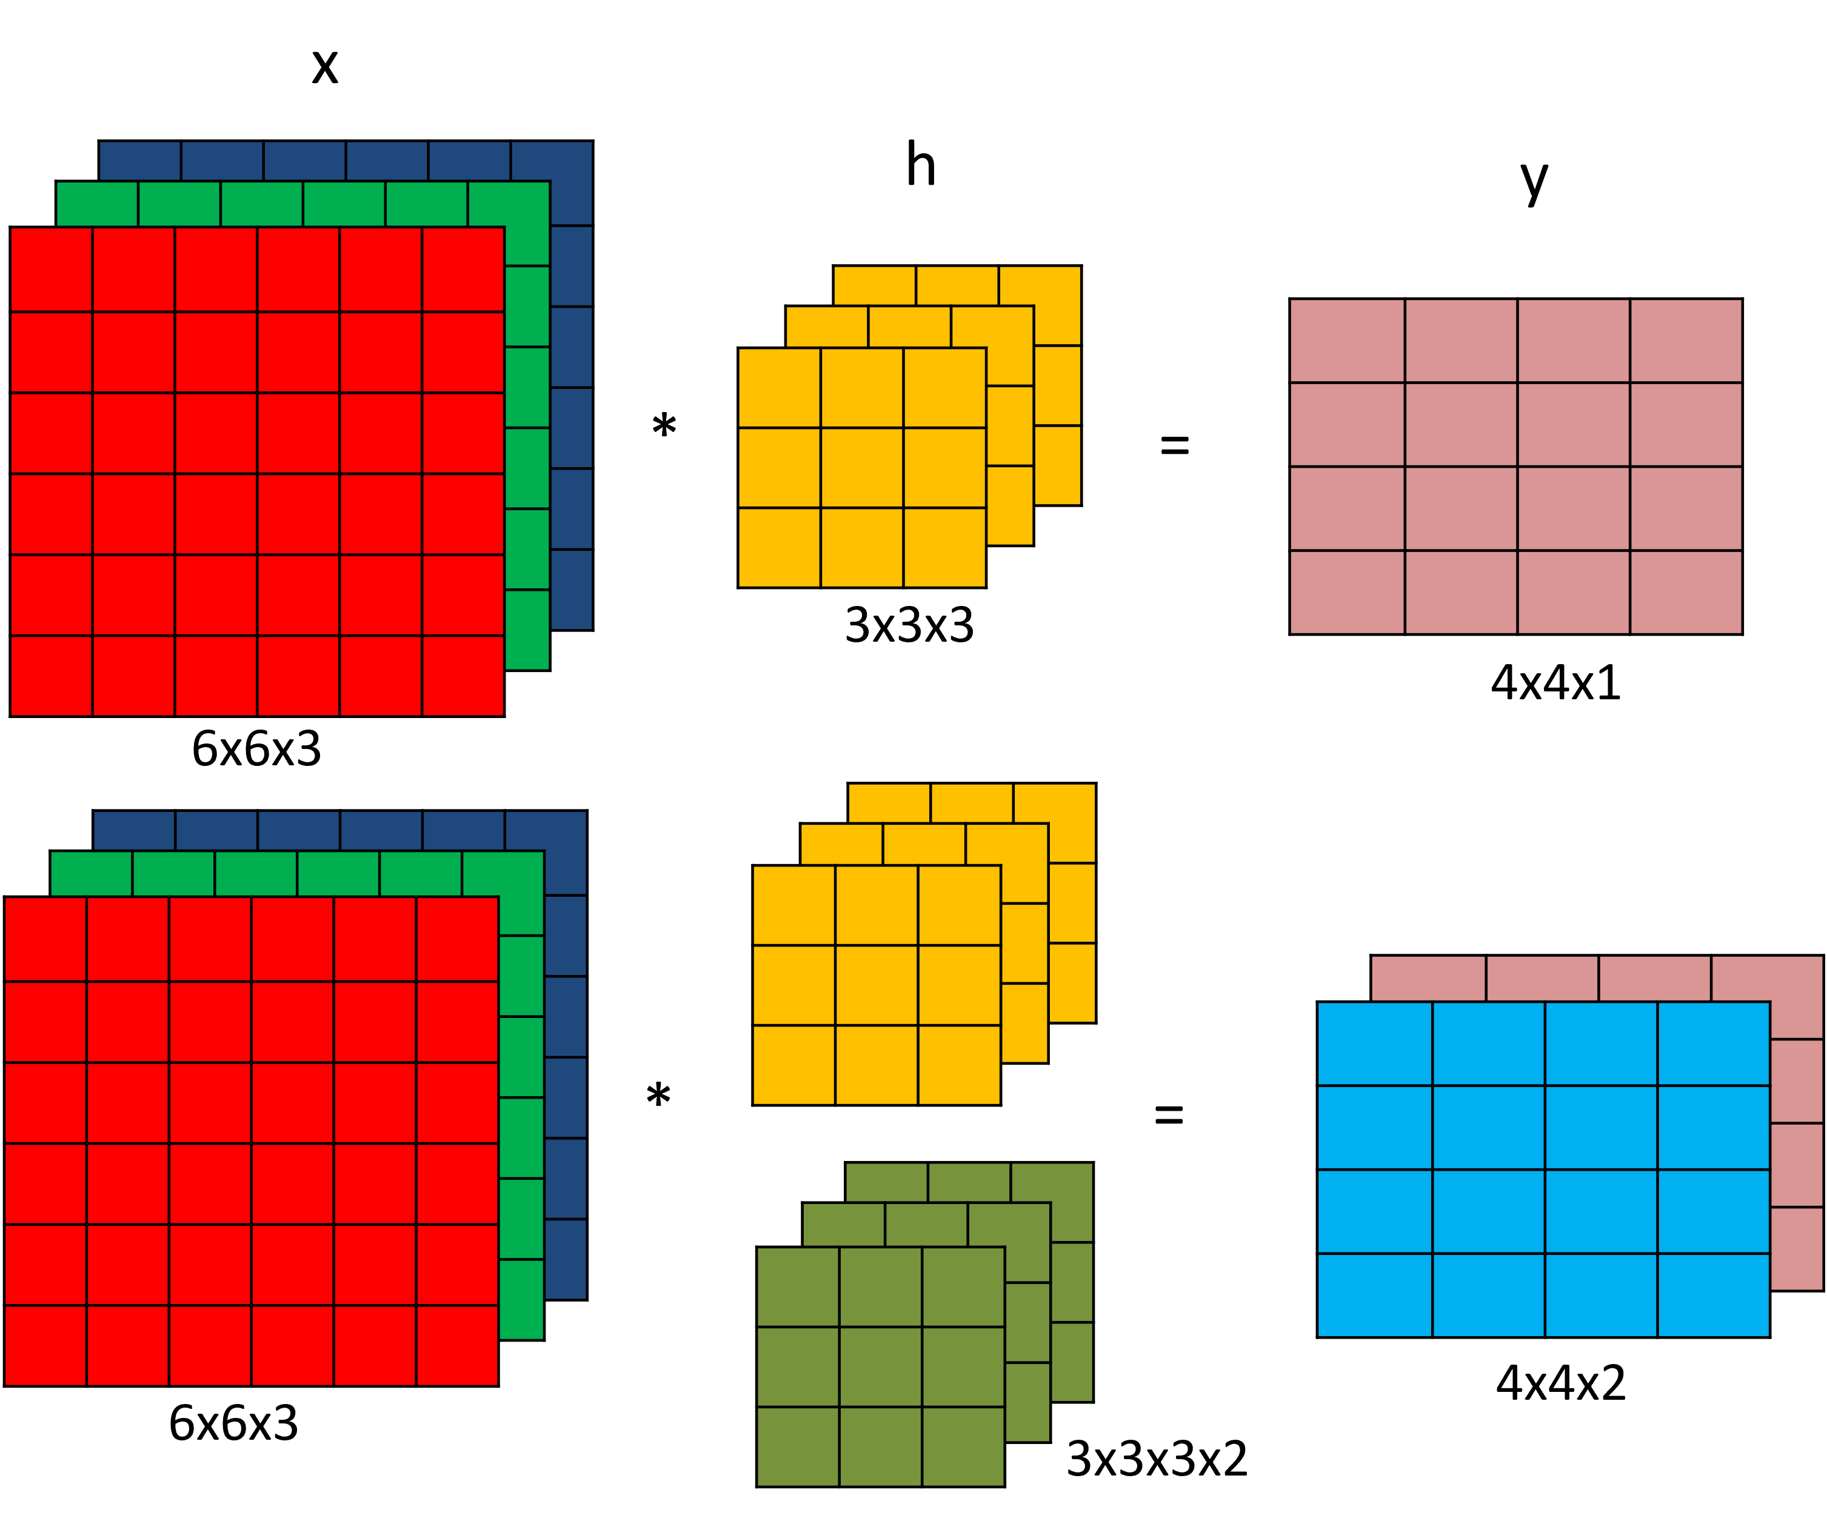
3D convolution

Slide 7
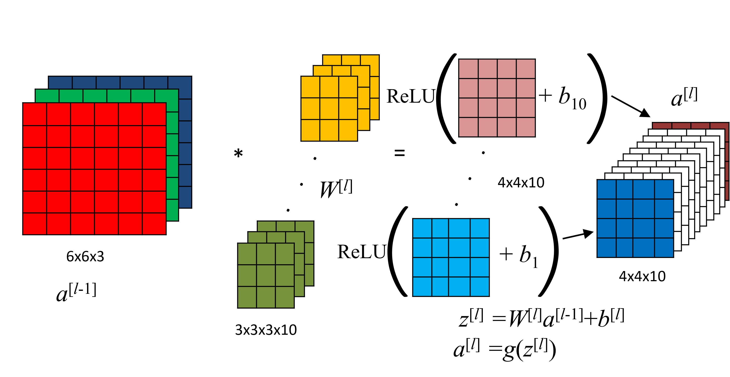
convolution layer in NN

Slide 8
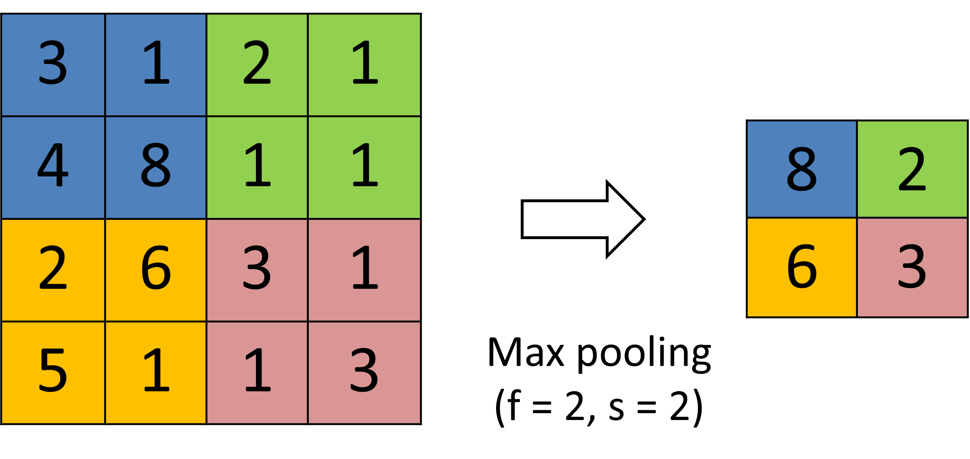
max pooling layer

Slide 9
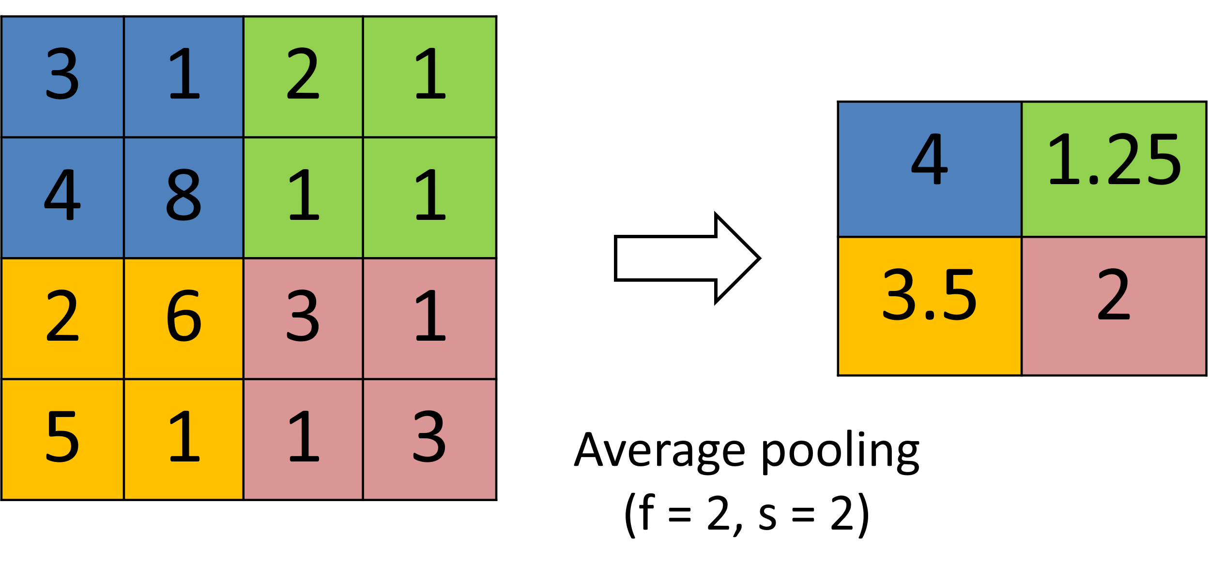
average pooling layer

Slide 10
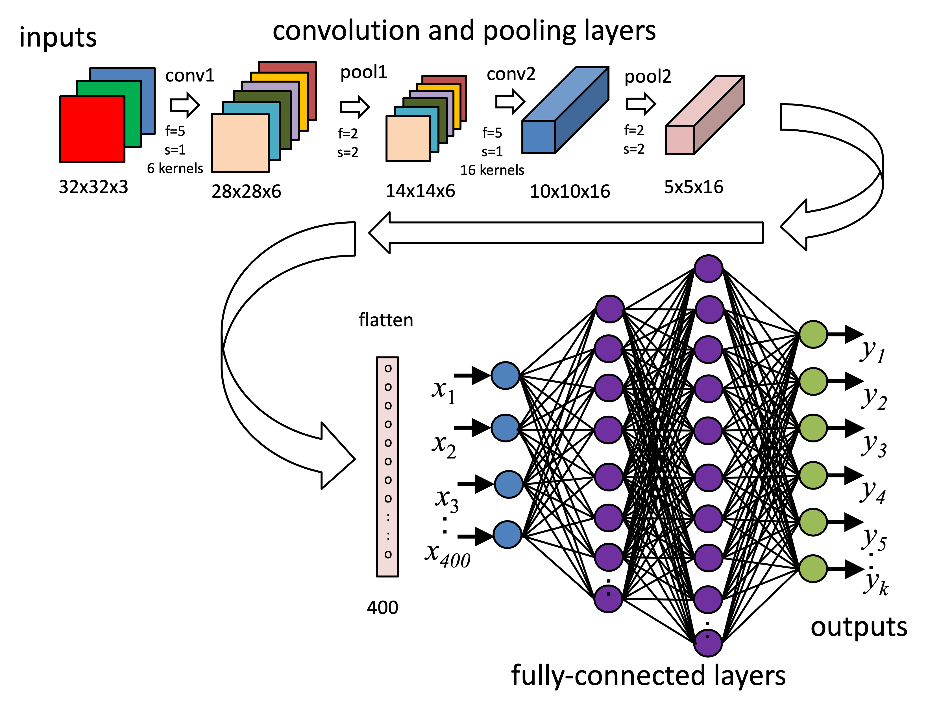
CNN model example
see ตัวอย่าง 4.2

Slide 11
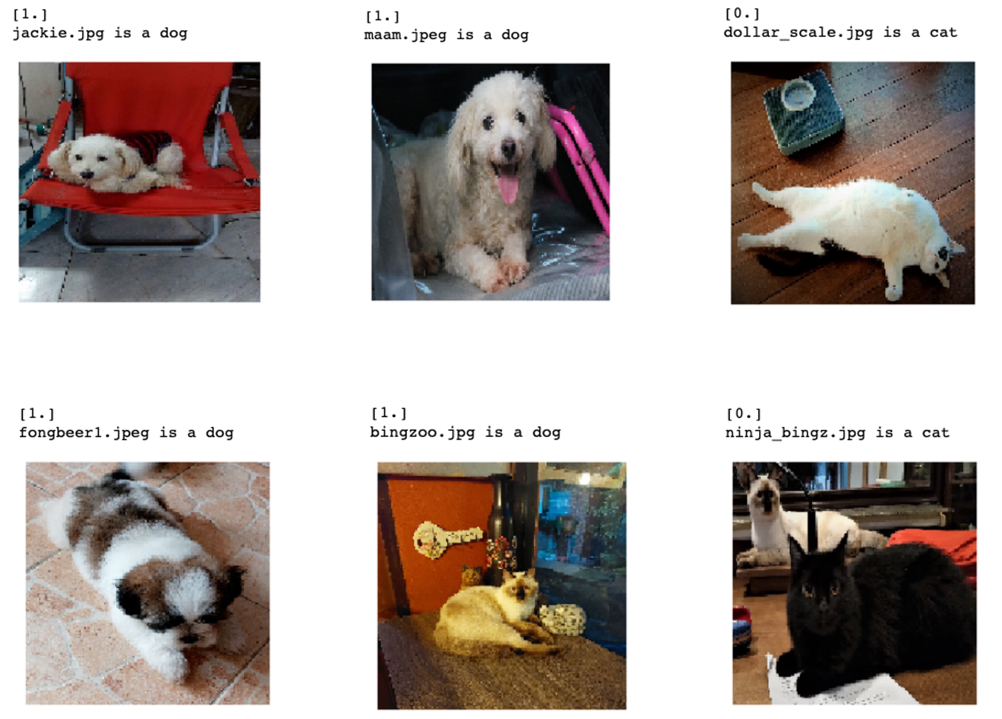
cat/dog classification

Slide 12
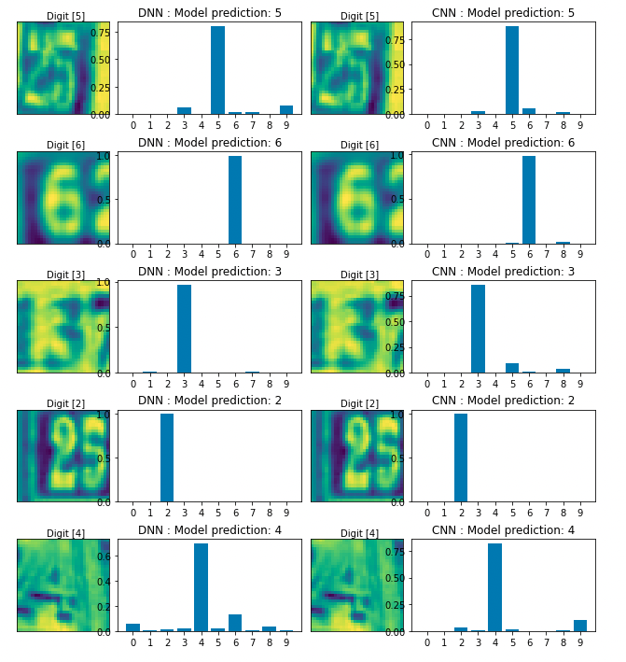
DNN/CNN comparision (SVHN)

Slide 13
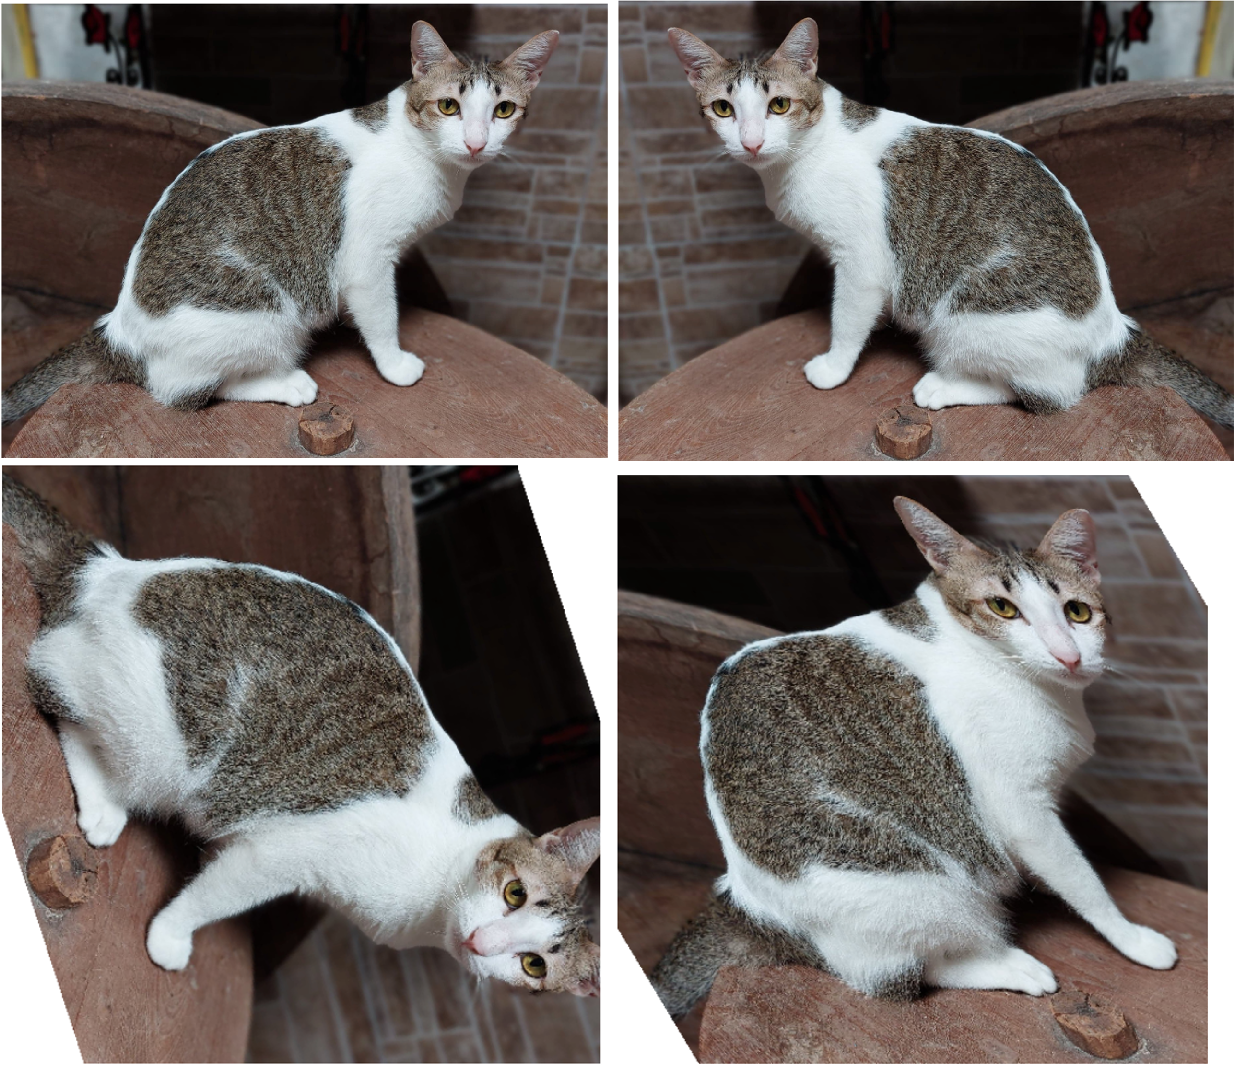
image augmentation

Slide 14
CNN case study
LeNet-5
AlexNet
VGG-16
ResNets
Inception model

Slide 15
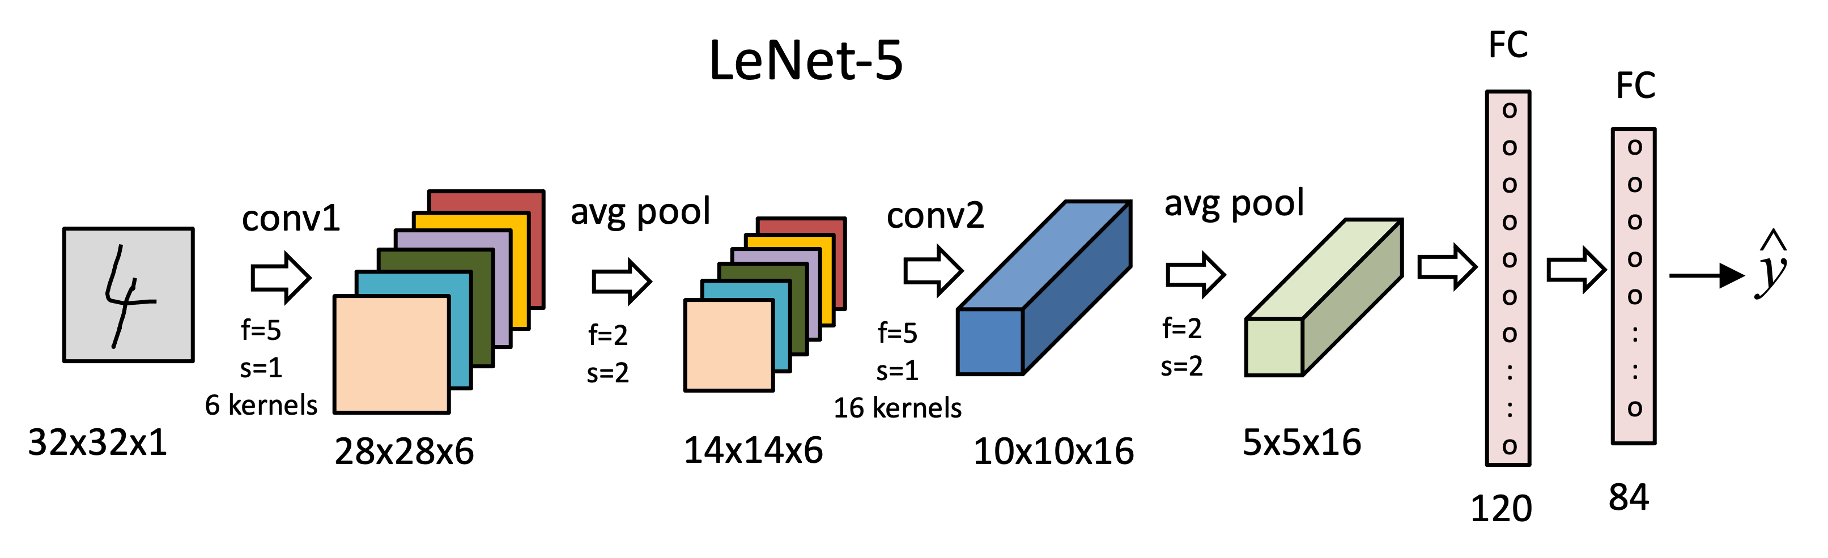
LeNet-5
LeCun, Y.; Boser, B.; Denker, J. S.; Henderson, D.; Howard, R. E.; Hubbard, W. & Jackel, L. D. (1989). Backpropagation applied to handwritten zip code recognition. Neural Computation, 1(4):541-551.

Slide 16
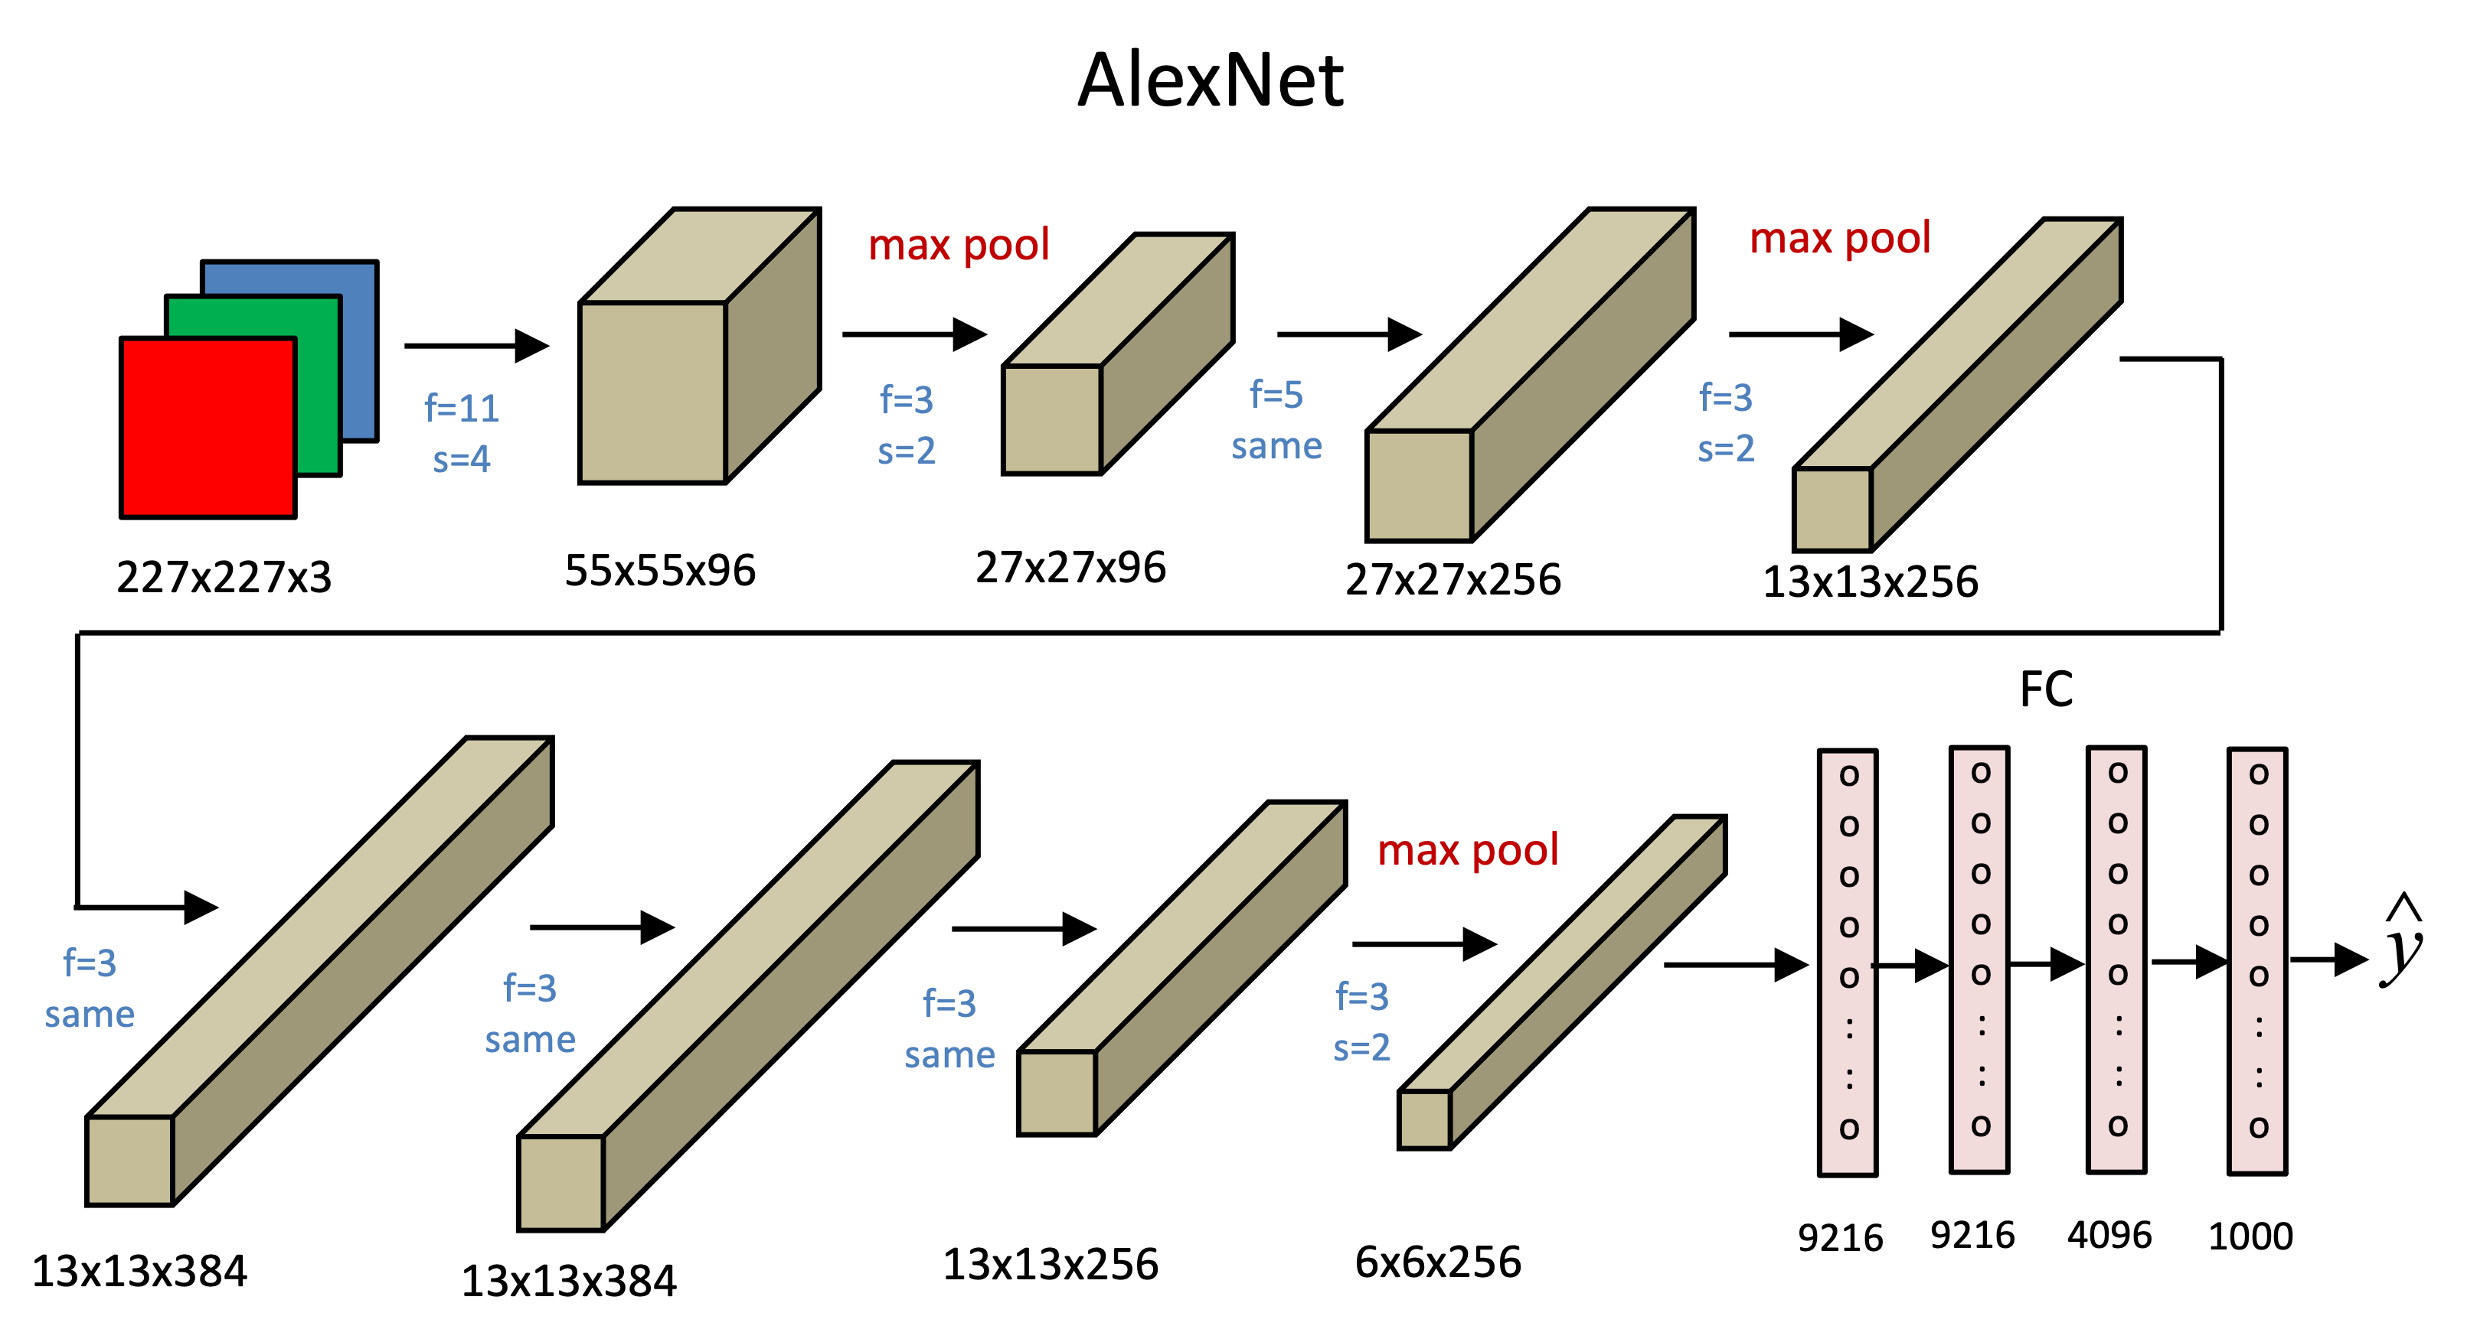
AlexNet
Krizhevsky, Alex; Sutskever, Ilya; Hinton, Geoffrey E. (2017-05-24). "ImageNet classification with deep convolutional neural networks"

Slide 17

VGG-16
Simonyan Sisserman. Very deep convolution networks for large-scale image recognition. 2015.

Slide 18
ResNets
He, K; Zhang X; Ren S.; Sun J.; Deep residual learning for image recognition. CVPR. 2015.

Slide 19
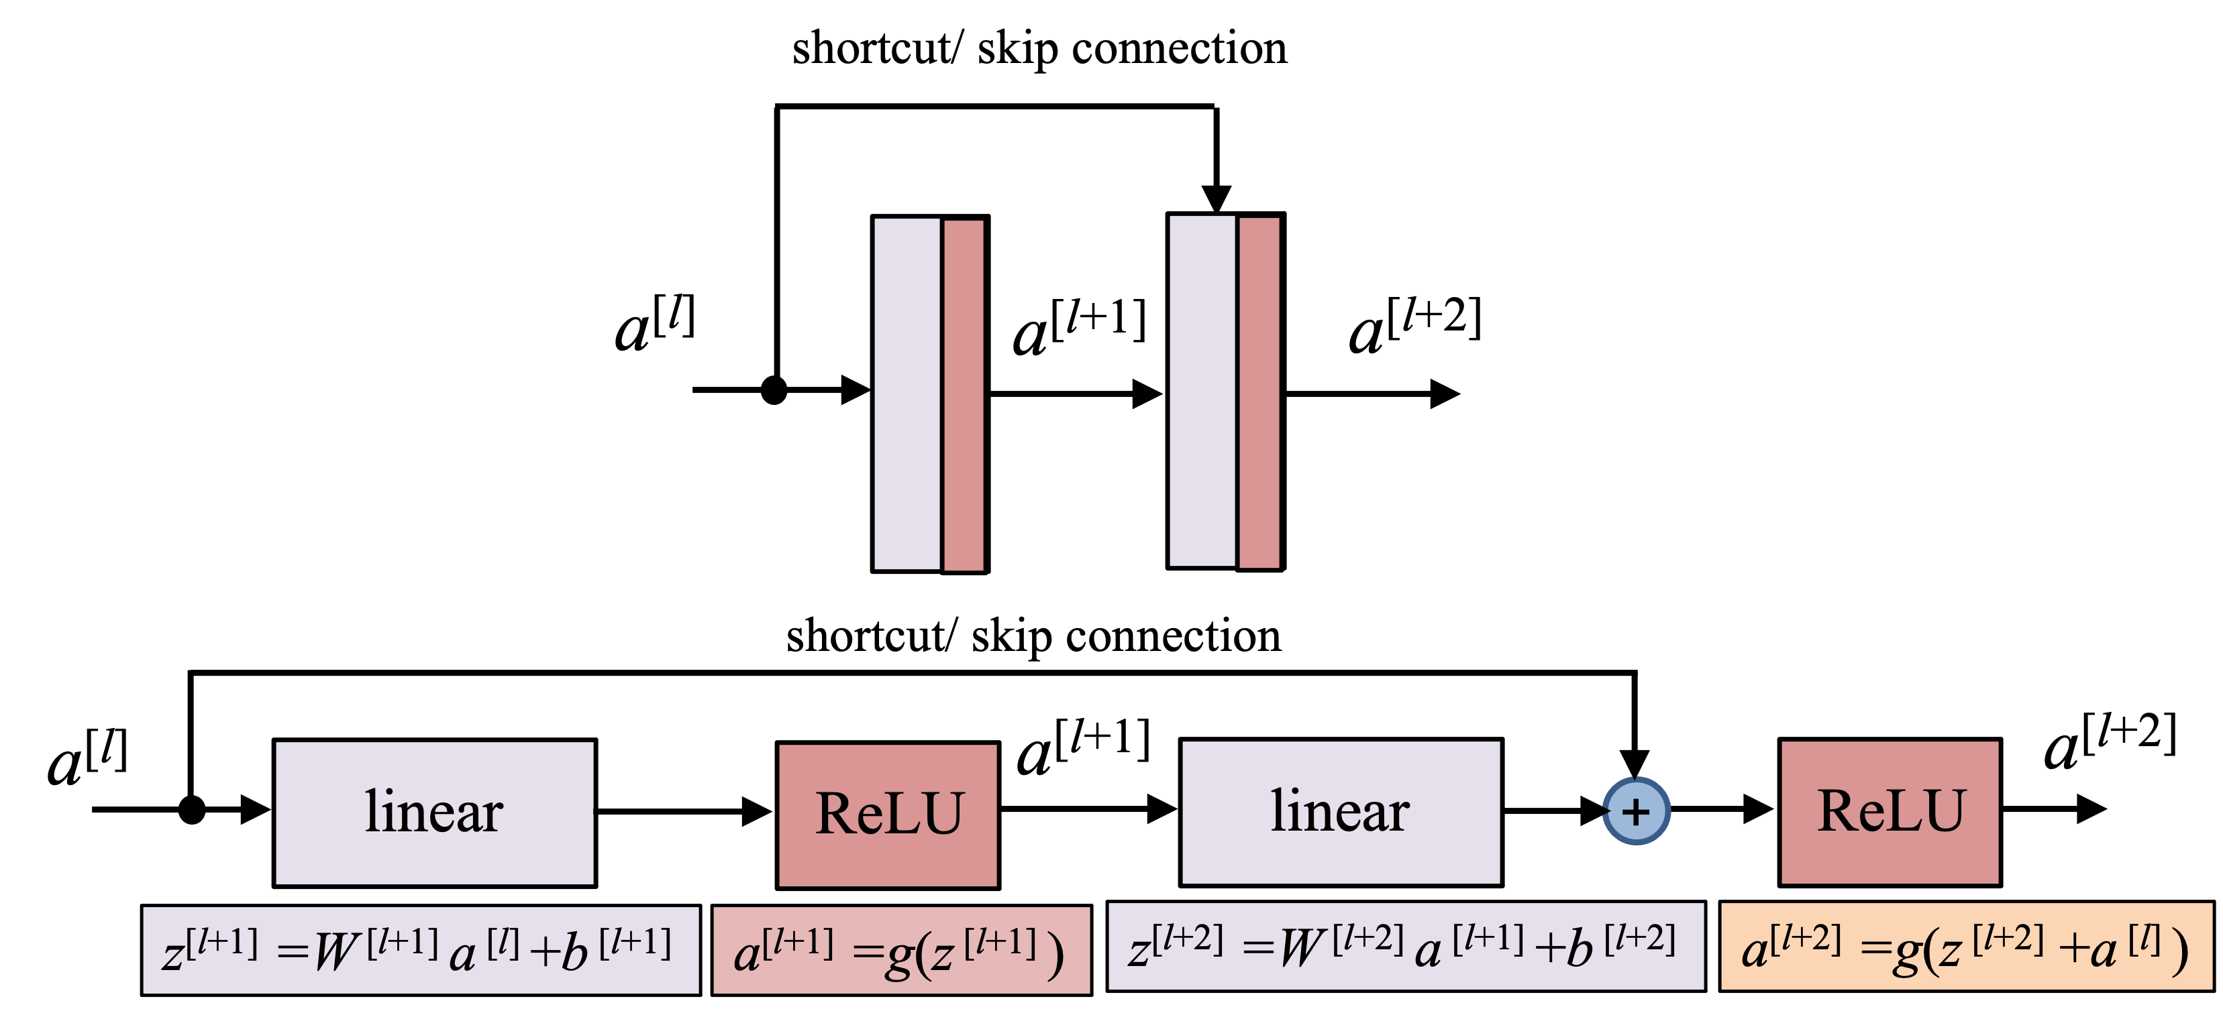
Residual block

Slide 20
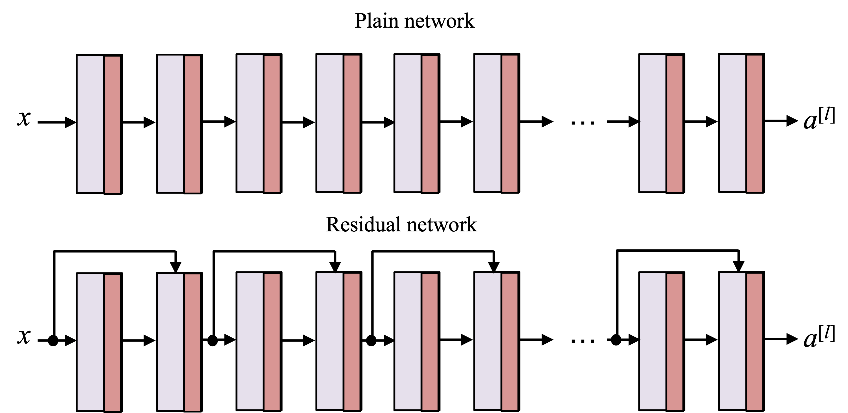
Plain v.s. residual network

Slide 21
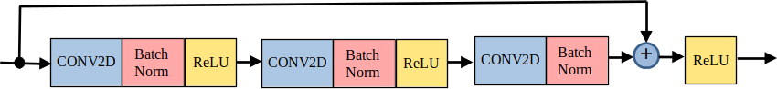
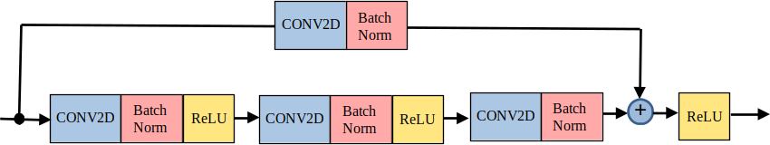
construct ResNets in TensorFlow
identity block
convolution block

Slide 22
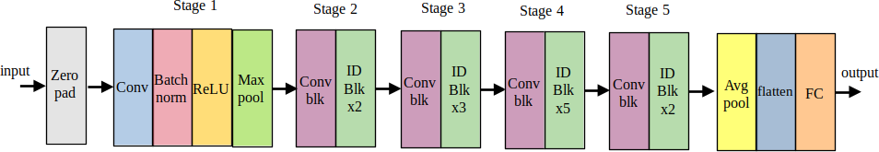
ResNet50 model

Slide 23
Inception model
Szegedy et al. Going deeper with convolutions. 2014.

Slide 24
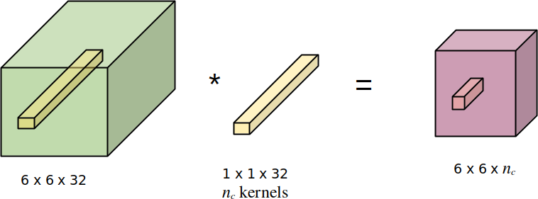
Convolution using 1x1 kernel

Slide 25
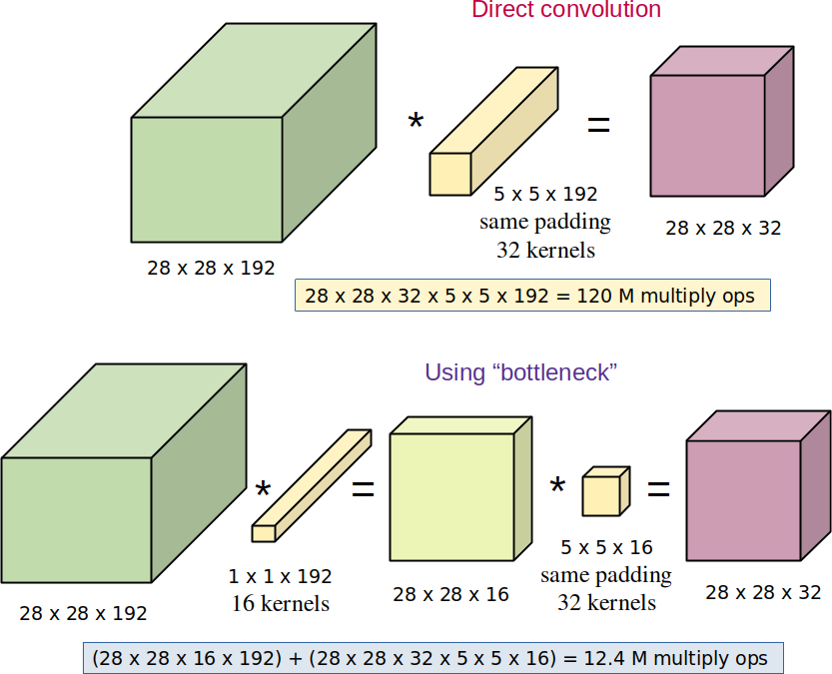
Implement “bottleneck” with 1x1 convolution

Slide 26
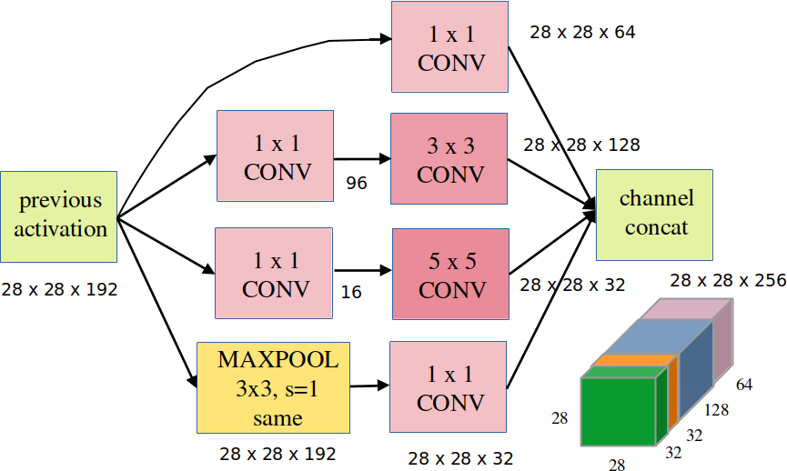
Inception module

Slide 27
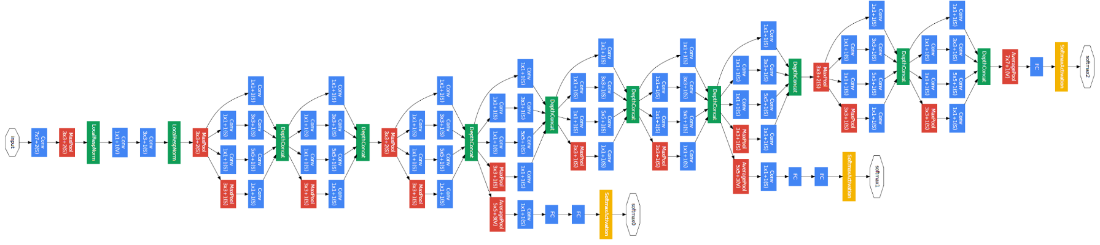
googLenet

Slide 28
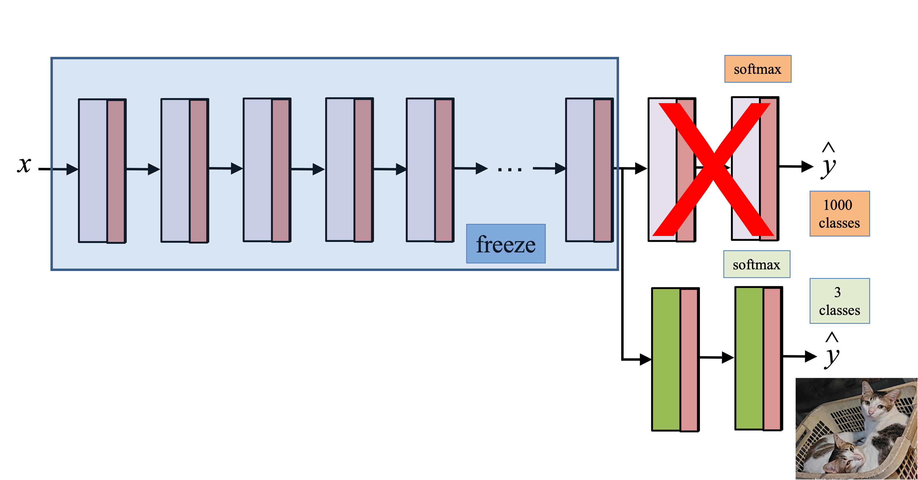
transfer learning

